Slide 1
Financial Aid Issues in a
Competency-Based Education Model
Sally Johnstone and Bob Collins
CASFAA Conference – San Francisco
December 15, 2013

Slide 2
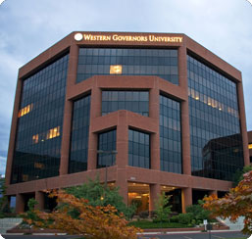
Competency-Based Education
Sally M Johnstone
Vice President for Academic Advancement
Western Governors University

Slide 3
The principal mission of Western Governors University is to improve quality and expand access to post-secondary academic opportunity by providing a means for individuals to learn independent of time or place and to earn competency-based degrees and other credentials that are credible to both academic institutions and employers.
Western Governors University
Founded in 1997
Notes:
Competency-based education defines educational goals in terms of demonstrable, measurable descriptions of the knowledge, skills/abilities, and behaviors students should
possess at the end of a
program. These outcomes
are those required by the
workforce as they graduate and enter the profession or transfer to another university’s program.
Competencies describe the understanding, skills and professional values
required of a student that are essential for beginning the unsupervised
practice of a career.
Students in traditional discipline-based instructional content courses
largely learn what teachers choose to teach them. The courses aim to
produce an employee (or student of even higher education) with pre-
scribed packages of knowledge, some of which will be retained upon
graduation.
However, a competency-based curriculum identifies what is essential for
professional practice, and then provides a sequence of defined learning
experiences so that the student may graduate as a qualified beginner.

Slide 4
Where are we now?
Colleges: Information Technology, Business, Teacher Education, and Health Professions
Students are full-time, degree seeking at Baccalaureate and Masters level
Current enrollment > 40,000

Slide 5
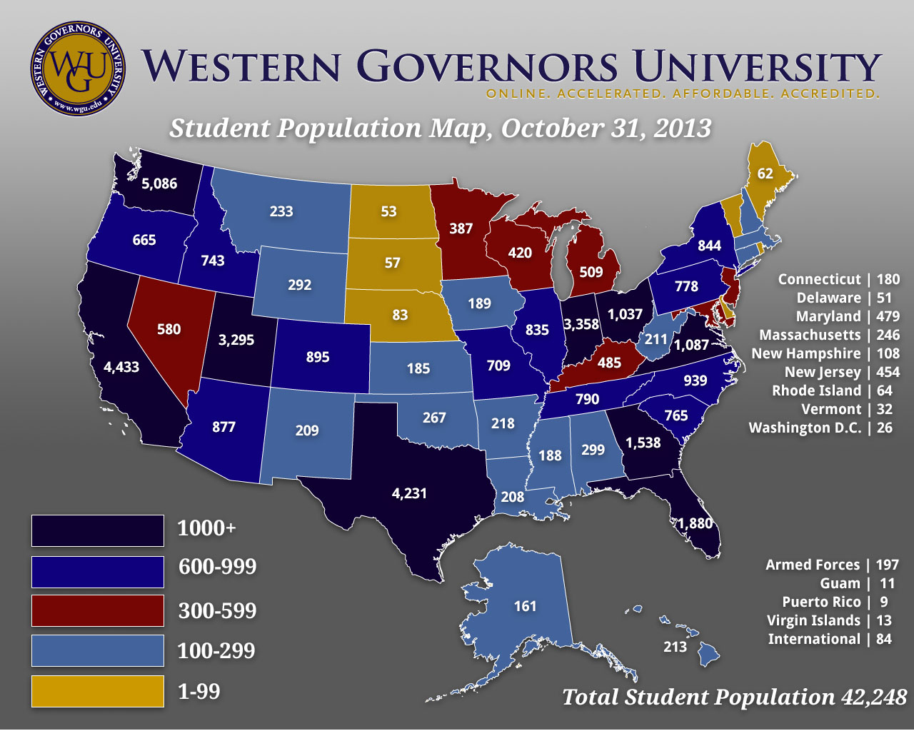

Slide 6
Most successful students –
start with some college experience
have work experience
motivated to earn degree
average age is 37 years
Notes:
Most public post-secondary education and K-12 schools in the U.S. were designed on a very different model at a time that pre-dates the types of technology we have readily available today – for academic delivery and student tracking.
Funding models were based on opening access --- funding formulae are based on levels of enrollment usually measured on the 10 day of classes each fall term. That was a good model but we now know it is not enough – we also have to consider student success.
As we begin to evolve into new models of funding there are some important things to keep in mind that can constitute barriers to the shift to performance funding:
Need for clear definitions of why we want to make this shift.
Several constituency groups must agree what performance funding is supposed to accomplish – the desired ends must be defined so measures can be developed to see if progress is being made.
Legislators, Governors, higher education representatives (SHEEO officers), school districts must all be able to understand what the desired end state is.
What is the performance on which funding will be dependent?
Student graduation rates, or approximations of that.
Course completion - i. e., funding is based not on 10 day head counts but numbers of students successfully passing their courses in a term
Critical to stay concise – funding should reflect different missions of institutions (open access, highly selective, research intensive, etc.) but lesson from the 1990’s – can not have 37 sets of performance measures or it can not be administered.
Information of performance must be shared at all levels – students, faculty, administrators & policy makers

Slide 7


Critical Elements of WGU Model for Student Success
Faculty/Mentors

Slide 8
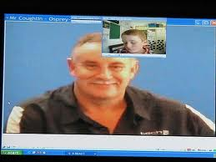
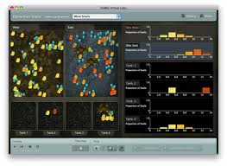

Critical Elements of WGU Model
Learning materials
-leverage buying power
-tracking student use

Slide 9



Critical Elements of WGU Model
Assessments
-mapped to competencies
-secure

Slide 10
Growing Interest in CBE
Carnegie Foundation for the Advancement of Teaching re-examining the ‘Carnegie Unit’
Foundations working with regional accreditors and Dept of Ed to assure financial aid for CBE
Gates Foundation supported project includes WA, IN, FL & TX colleges as partners
Adapting and Adopting Competency-Based IT Instruction to Accelerate Learning funded by DoL’s (TAACCCT)

Slide 11
Partner Colleges Developing CBE Programs
Austin Community College, TX
Broward College, FL
Sinclair Community College, OH
FL – Valencia College
IN – Ivy Tech Community College (Ft Wayne & Lafayette)
TX – Lone Star Community College
WA – Bellevue College, Columbia Basin College, Edmonds Community College, Community College of Spokane

Slide 12
Design Principles for CBE
1. Degree reflects robust and valid competencies.
2. Students are able to learn at a variable pace and are supported in their learning.
3. Effective learning resources are available to students anytime and are reusable.
4. The process for mapping competencies to courses/learning outcomes/assessments is explicit.
5. The assessments are secure and reliable.

Slide 13

Challenging Policies

Slide 14
Financial Aid Issues
Bob Collins
Vice President Student Financial Aid
Western Governors University

Slide 15
WGU Background
HEA Reauthorization 1998 – eligible institution
Distance Education Demonstration Program
  Competency-based Model
    Education Domains
    No Grades (Narrative Transcript)
    Unbundled Faculty Model (Mentoring)
  Direct costs only in cost of attendance calculation
  Non-Term (6 month payment periods)
  SAP 100% Term
  Students start 365 days a year
  100% Distance Education

Slide 16
WGU Background
Lessons Learned
  Introduction of Competency Units (CUs)
  Non-Standard Term – borrower based academic year
  6-Month Terms begin on the first of each month
  Grades of Pass and Not Pass
  66.67% Cumulative Satisfactory Academic Progress (SAP)
  Flat term-based tuition that encourages acceleration
  Cost of Attendance – EFC = Need (Sub/Unsub eligibility)
Veterans Benefits and State Funded Student Assistance
    Consult state agencies

Slide 17
Measurement of SAP
Competency Based Model
Degree Plan
Academic Activity Verification (AAV)
Qualitative Measure (Pass = B or better)
  Mastery of subject mater
Quantitative Measure
  Attempted versus completed
SAP appeal approval requires Academic Plan
On-Time Progress (OTP) to Graduation
  At least 12 CUs per six month term

Slide 18
SAP Overview
Financial aid only awarded up to 150% of the program length
At least 66.67% Cumulative SAP = Good Standing
Less than 66.67% Term SAP = Warning
New students less than 3 CUs per term = Terminated
SAP Appeals
  Extreme Medical, Loss of Job, Disability, Death
    Documentation & Situation Improvement
  Unintended consequences
    Meeting OTP in a term does not necessarily mean the student is meeting cumulative SAP requirements
    12/20 = 60.00% - OTP is good, SAP is bad - discouraging

Slide 19
Other Regulatory
Definition of Credit Hour 34 CFR 600.2
  www.ifap.ed.gov Hot Topics - Program Integrity
Distance Education Definition 34 CFR 600.2
  …support regular and substantive interaction between students and faculty
Direct Assessment 34 CFR 668.10
  DCL GEN-13-10 (March 19, 2013)
Return to Title IV (R2T4)
  Academic Related Activity 34 CFR 668.22(l)(7)

Slide 20
34 CFR 668.22(l)…
(7)(i) “Academic attendance” and “attendance at an academically-related activity”—
Include, but are not limited to—
(1) Physically attending a class where there is an opportunity for direct interaction between the instructor and students;
(2) Submitting an academic assignment;
(3) Taking an exam, an interactive tutorial, or computer- assisted instruction;
(4) Attending a study group that is assigned by the institution;
(5) Participating in an online discussion about academic matters; and
(6) Initiating contact with a faculty member to ask a question about the academic subject studied in the course; and

Slide 21
34 CFR 668.22 (l)(7)…
(B) Do not include activities where a student may be present, but not academically engaged, such as—
(1) Living in institutional housing;
(2) Participating in the institution's meal plan;
(3) Logging into an online class without active participation; or
(4) Participating in academic counseling or advisement.
(ii) A determination of “academic attendance” or “attendance at an academically-related activity” must be made by the institution; a student's certification of attendance that is not supported by institutional documentation is not acceptable.

Slide 22
Determining Last Date of Attendance (LDA)
Institution required to take attendance?
www.ifap.ed.gov Program Integrity Q&A: R2T4
  TA-Q2: If an institution monitors whether its online students log into classes, is this an institution that is required to take attendance?
  TA-A2: No. The monitoring of whether online students log into classes does not by itself result in an institution being an institution that is required to take attendance for Title IV, HEA program purposes. If, however, the monitoring of student activity is tracking academic engagement, then the institution would be an institution that is required to take attendance for Title IV, HEA program purposes.

Slide 23
Student Fraud Considerations
WGU Orientation
  Begins the 15th of each month
  Setting proper expectations – academic and financial
Delay disbursement for ALL new students
  30 day delay (45+ days of academic effort before $$$ )
Duplicate address reports (US and E-mail, IP)
Third party identity management/biometrics
Verification of identity – new in 2013-2014
  Notarized statement of educational purpose

Slide 24
Questions and Comments

