Slide 1
California State Compliance
Are you Ready?
Spring 2020

Slide 2
Welcome!
Bronwyn Garrison
2020 CASFAA Vice President, State Issues
Assistant Director Compliance
University of California, San Diego

Slide 3
Agenda
Goal
Section 1: State Bills in Law
AB 2: Community College Promise **UPDATE**
AB 540: California Dreamer Service Incentive Grant Program **UPDATE**
AB 1313 Prohibited debt collection practices
AB 1774 CSAC: Extension of application deadlines
Section 2: Current State Legislation
Where are we now?
Thank you!

Slide 4
Goal
Starting point:
Create awareness
Provide Resources
You are not alone!
Notes:
Create awareness of current and new state issues
Not all but high impact based on review of CASFAA State Issues and Training Committee

Slide 5
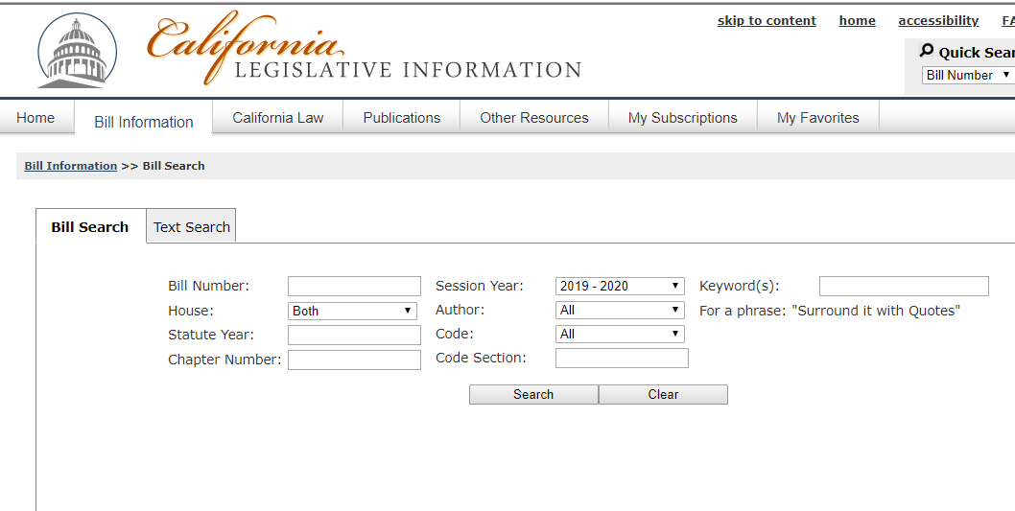
Section 1: State Bills in Law
http://leginfo.legislature.ca.gov
Notes:
The CASFAA Executive Council and State Issues committee focus on bills that are likely to effect the most members
Will have links to passed bills but can always look up by Bill Summer and House (either AB- Assembly Bill or SB- Senate Bill)

Slide 6
AB 2 Community College Promise
When?
January 1, 2020
Who?
California Community Colleges
Where?
https://leginfo.legislature.ca.gov/faces/billTextClient.xhtml?bill_id=201920200AB2

Slide 7
AB 2 Summary
Adjusts existing law:
Students with a previous degree or certificate are ineligible for the fee waiver.
For purposes of the fee waiver, the school can “deem” someone not enrolled in 12 or more semester units to be considered full time.
By a staff person in the disabled student services program at the institution who is qualified to make such a designation
Notes:
Considerations:
Law requires student have a FAFSA or CADA on file
Who is the designated staff member on your campus, set up systems to allow for fee waiver to process, work with your Accounting office? Noted in procedures?

Slide 8
AB 540 California Dreamer Service Incentive Grant Program
When?
2019-2020 Academic Year
Who?
UC
CSU
California Community Colleges
Independent institution of higher education
Where?
http://leginfo.legislature.ca.gov/faces/billTextClient.xhtml?bill_id=201920200AB540

Slide 9
AB 540 Summary
Adjust existing law:
Change the name of the Cal Grant B Service Incentive Grant Program to the California Dreamer Service Incentive Grant Program.
Require participating program to have been “established for a minimum of 2 years before the first date on which a participating student begins performing service hours to qualify for the program”
California Student Aid Commission
Notes:
Inquiring organizations see CSAC

Slide 10
AB 1313 Prohibited debt collection practices
When?
January 1, 2020
Who?
UC
CSU
California Community Colleges
Where?
https://leginfo.legislature.ca.gov/faces/billTextClient.xhtml?bill_id=201920200AB1313

Slide 11
AB 1313 Summary
A school shall not do any of the following:
Refuse to provide a transcript for a current or former student on the grounds that the student owes a debt.
Condition the provision of a transcript on the payment of a debt, other than a fee charged to provide the transcript.
Charge a higher fee for obtaining a transcript, or provide less favorable treatment of a transcript request because a student owes a debt.
Use transcript issuance as a tool for debt collection.

Slide 12
AB 1774 Student Aid Commission: Extension of application deadlines
When?
October 19, 2019
Who?
All Cal Grant awarding institutions
Where?
https://leginfo.legislature.ca.gov/faces/billTextClient.xhtml?bill_id=201920200AB1774

Slide 13
AB 1774 Summary
CSAC can postpone an application deadline of up to 30 calendar days for any financial aid program administered by the commission
Requires formal postponement request from
the Superintendent of a school or community college district or
President or Chancellor of a California institution of higher education
Qualifying event can include:
A natural disaster.
A state of emergency declared by the Governor or the President of the United States.
A labor action.

Slide 14
Section 2: Current State Legislation
Currently in year 2 of a two year cycle (2019-2020).
Legislative priority: economy and response to COVID-19

Slide 15
State Legislation: Pending bills
AB 2016: Student Aid Commission: total cost of attendance calculator.
5/7/20: Re-referred to Com. on HIGHER ED
http://leginfo.legislature.ca.gov/faces/billNavClient.xhtml?bill_id=201920200AB2016
AB 3086: Student financial aid: scholarship displacement.
5/5/20: Re-referred to Com. on HIGHER ED
http://leginfo.legislature.ca.gov/faces/billHistoryClient.xhtml?bill_id=201920200AB3086

Slide 16
Important Dates
May 15: Governor released revised budget based on the current economic forecast
http://www.ebudget.ca.gov/
Golden State Teachers Program:
Reduced Fund
Federal funds allocation to Special Education Specialization
CSAC pending additional guidance for processing
Notes:
The May Revision preserves community college free tuition waivers and maintains Cal Grants for college students, including the grants for students with dependent children established last year.

Slide 17
Important Dates- continued
June 15: Deadline for Legislature to pass a state budget- differences between houses are reconciled in conference committee
Before July 1: Governor acts on the budget- approves all or reduced based on line-item vetoes
August 2020: Anticipated revisiting of budget based on economic forecast
Notes:
The May Revision preserves community college free tuition waivers and maintains Cal Grants for college students, including the grants for students with dependent children established last year.

Slide 18
Governor’s Executive Order: Regulatory Relief
Deadline extended GPA Submission Cal Grant Entitlement
September 2, 2020 (vs May 16, 2020)
Waiver Selective Service Dream Student Verification
2019-2020 and 2020-2021
Cal Grant Special Alert:
https://www.csac.ca.gov/sites/main/files/file-attachments/gsa_2020-19.pdf?1590623815
Executive Order:
https://www.gov.ca.gov/wp-content/uploads/2020/05/5.19.20-EO-N-65-20-text.pdf
Notes:
5/19/20
Also mentioned New Cal Grant A recipients self-certify high school completion on webgrants

Slide 19
Other useful State resources- California Student Aid Commission
COVID-19 webpage: https://www.csac.ca.gov/covid19
Latest updates
Training updates: online!
https://www.csac.ca.gov/post/upcoming-webinars-college-staff

Slide 20
Other useful State resources- California Student Aid Commission
Commission updates:
Open to Public
Next meeting July
Recordings and Transcripts: https://www.csac.ca.gov/commission-meeting-calendar-agendas-and-video-recordings

Slide 21
Thank you!
Want to join CASFAA?
https://www.casfaa.org/join-casfaa
Join the CASFAA State Issues Committee!
bgarrison@ucsd.edu
Interested in volunteering for training?
Get involved!
thalassa.naylor@salliemae.com

